Slide 1
In the Name of Allah, the most Beneficent, the most Gracious, the most Merciful

Slide 2
Exploratory Data Analysis (EDA) of US Accidents (2016 – 2021)

Slide 3
About the Dataset
This is a countrywide car accident dataset, which covers 49 states of the USA. The accident data are collected from February 2016 to Dec 2021, using multiple APIs that provide streaming traffic incident (or event) data. These APIs broadcast traffic data captured by a variety of entities, such as the US and state departments of transportation, law enforcement agencies, traffic cameras, and traffic sensors within the road-networks. Currently, there are about 2.8 million accident records in this dataset.

Slide 4
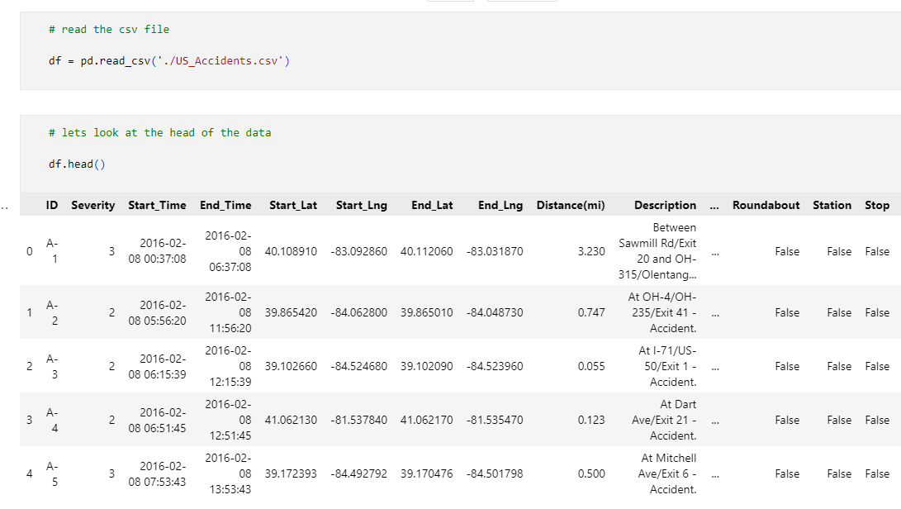
Import the Dataset

Slide 5
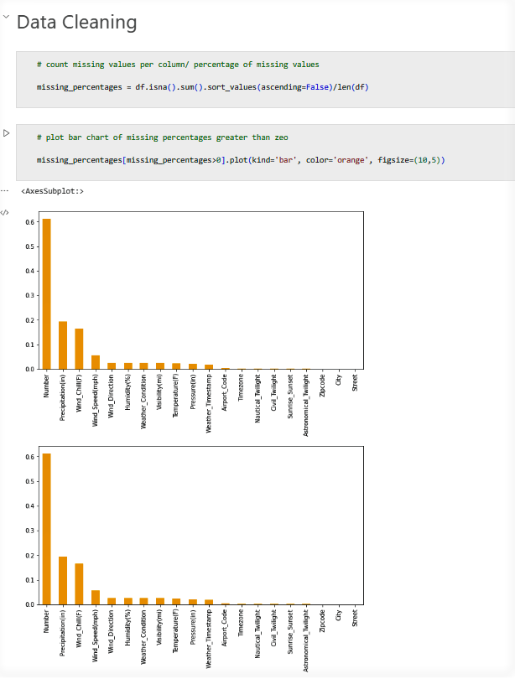
Data Cleaning (missing values)

Slide 6
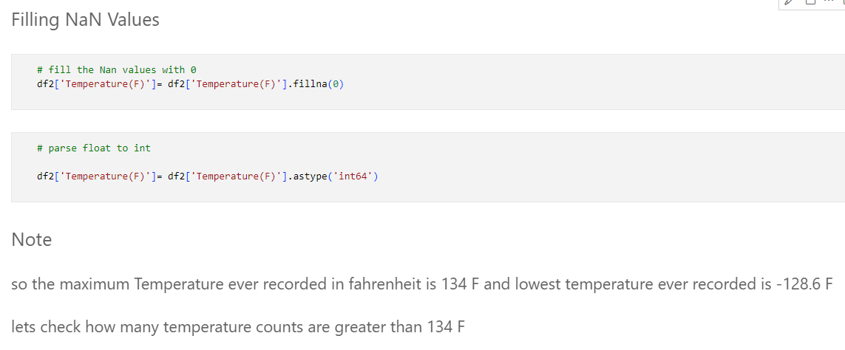
Data Cleaning (Filling NaN values)

Slide 7
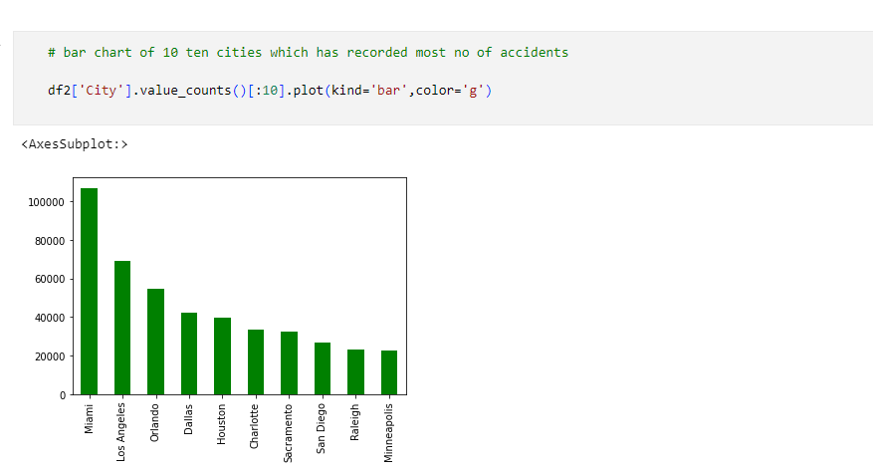
Bar chart of Top 10 cities which recorded most no of accidents

Slide 8
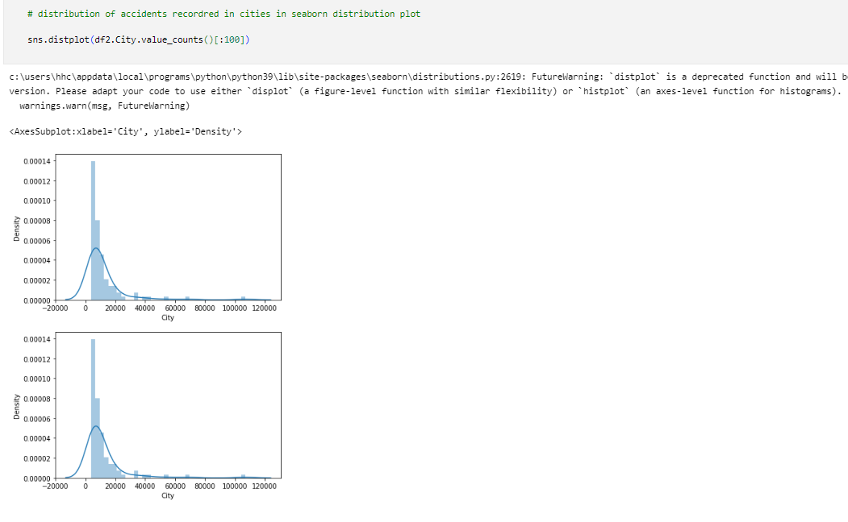
Distribution Plot of accidents recorded in cities

Slide 9
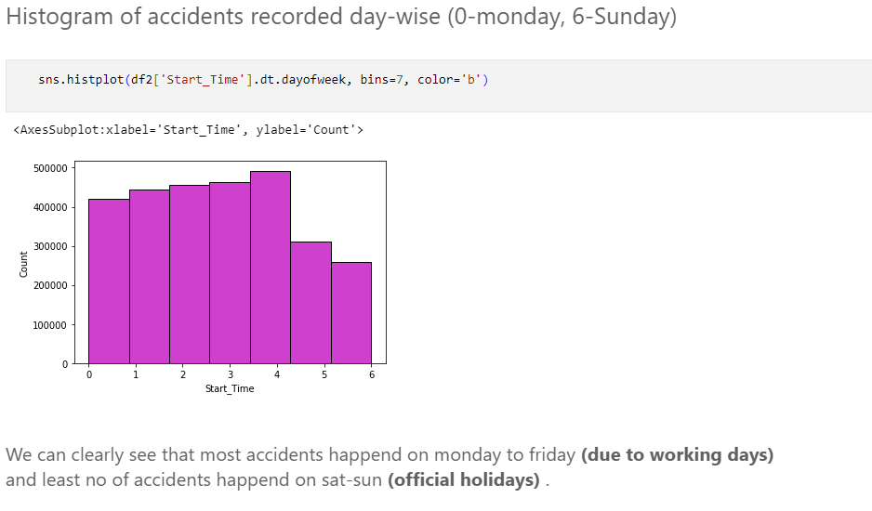
On which day most no of accidents recorded and why?

Slide 10
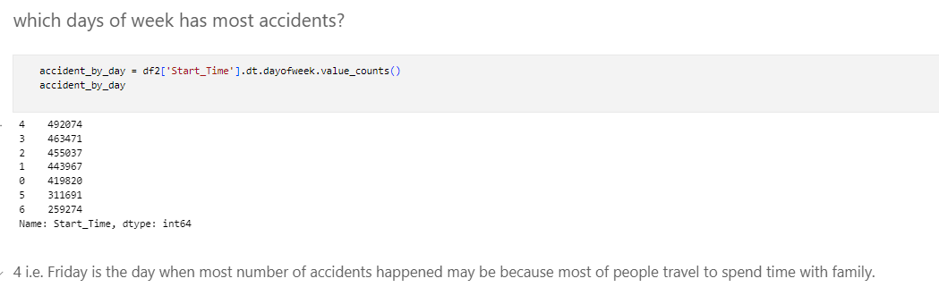
Friday is the day, when most no of accidents recorded?

Slide 11
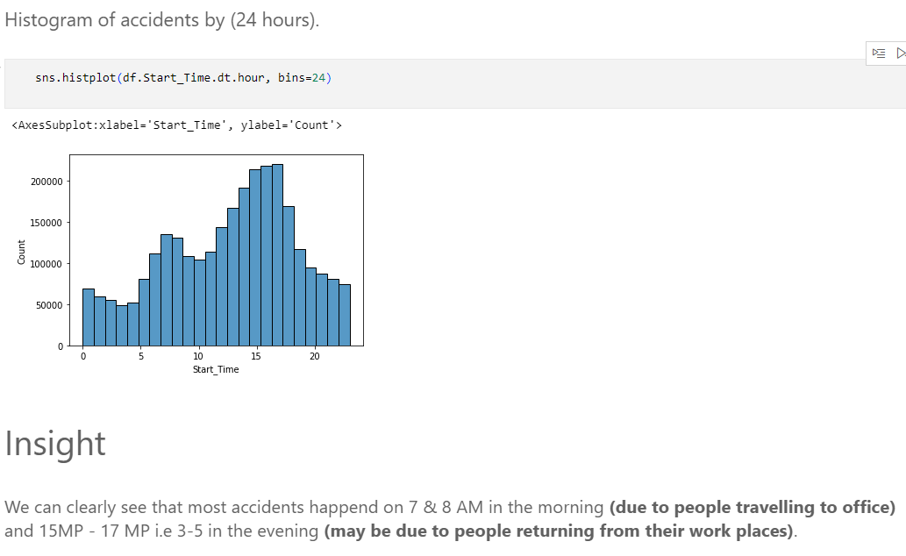
On which time of the day most no of accidents recorded and why?

Slide 12
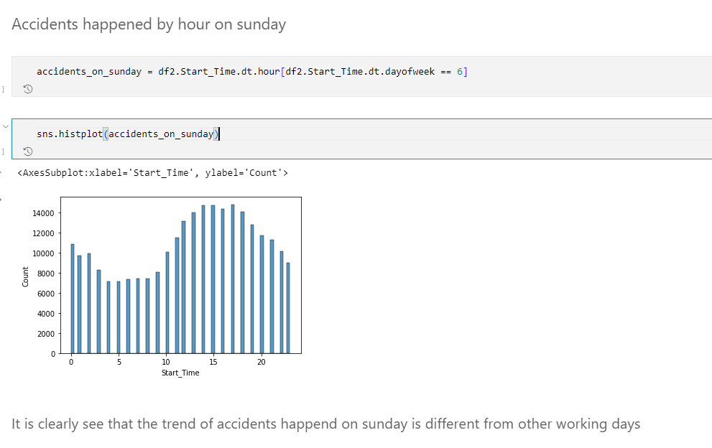
is distribution of accidents by hour is same on Sunday as compared to working day?

Slide 13
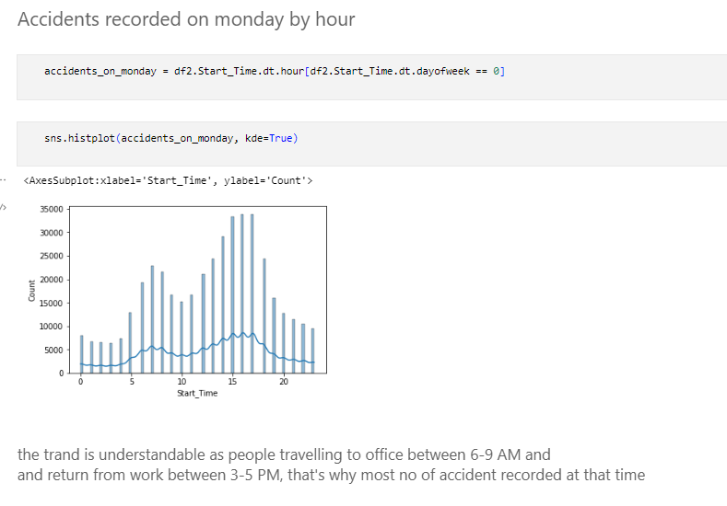
Distribution of accidents on Monday by hour

Slide 14
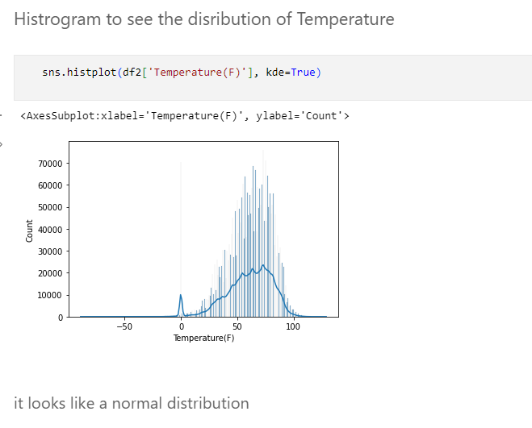
Distribution of temperature in which accidents recorded

Slide 15
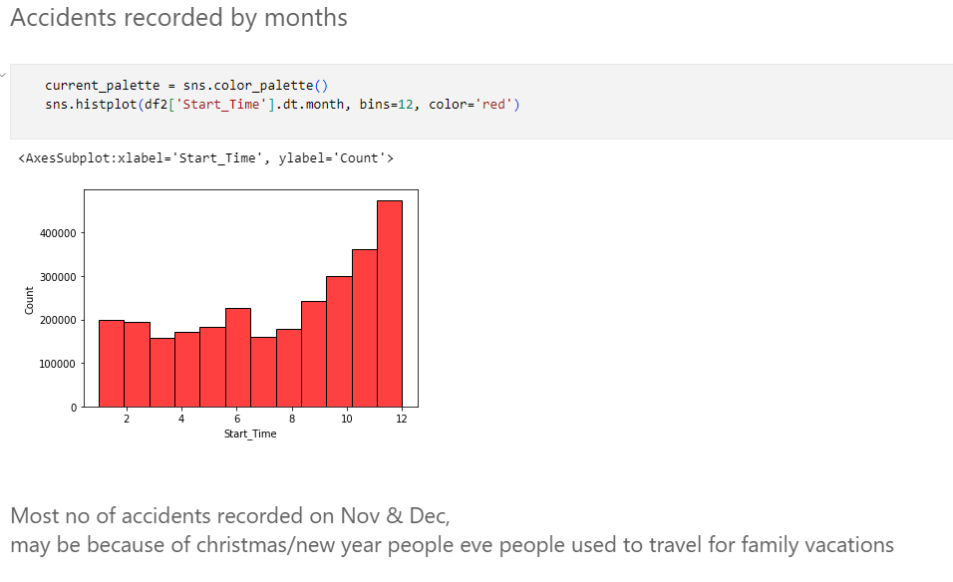
Accidents recorded by months

Slide 16
The End

